Slide 1
10 June 2020
1

Slide 2

APPLIED CRYPTOGRAPHY
Lecture 39
2

Slide 3
Birthday attack
Cracking cryptographic algorithms through matches in hash
3

Slide 4
RANDOM ORACLE MODEL
The Random Oracle Model, which was introduced in 1993 by Bellare and Rogaway, is an ideal mathematical model for a hash function.
Topics discussed in this section:
Pigeonhole Principle
Birthday Problems

Slide 5
x1 = Transfer $10 into Oscar’s account
x2 = Transfer $10,000 into Oscar’s account

Slide 6
Assume an oracle with a table and a fair coin. The table has two columns.
a. The message AB1234CD8765BDAD is given for digest calculation. The oracle checks its table.

Slide 7
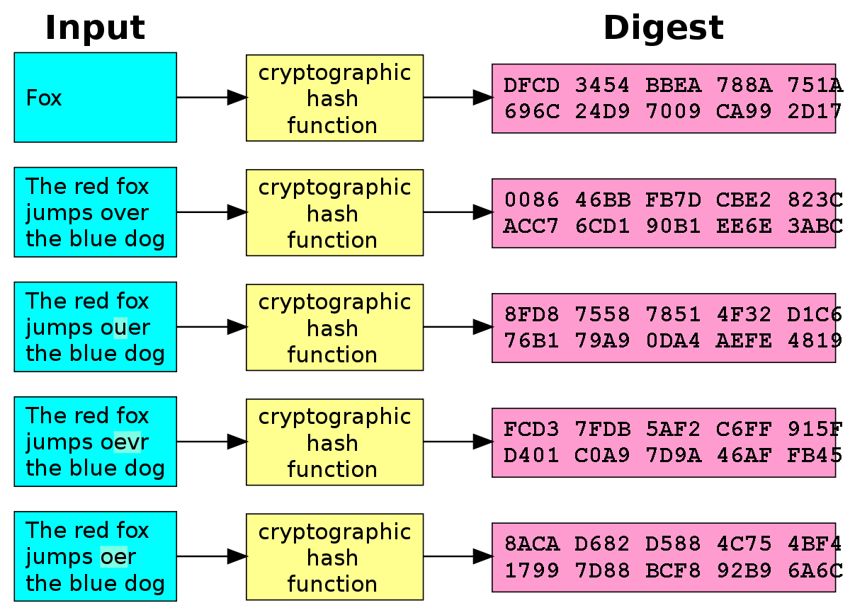
A message digest is a cryptographic hash function containing a string of digits created by a one-way hashing formula.
Message digests are designed to protect the integrity of a piece of data or media to detect changes and alterations to any part of a message.

Slide 8
Continued
b. The message 4523AB1352CDEF45126 is given for digest calculation. The oracle checks its table and finds that there is a digest for this message in the table (first row). The oracle simply gives the corresponding digest (13AB).

Slide 9
pigeonhole principle
The Pigeonhole Principle If k is a positive integer and k+1 or more objects are placed into k boxes, then there is at least one box containing two or more of the objects.

Slide 10
Assume that the messages in a hash function are 6 bits long and the digests are only 4 bits long. Then the possible number of digests (pigeonholes) is 24 = 16, and the possible number of messages (pigeons) is 26 = 64. This means n = 16 and kn + 1 = 64, so k is larger than 3. The conclusion is that at least one digest corresponds to four (k + 1) messages.

Slide 11
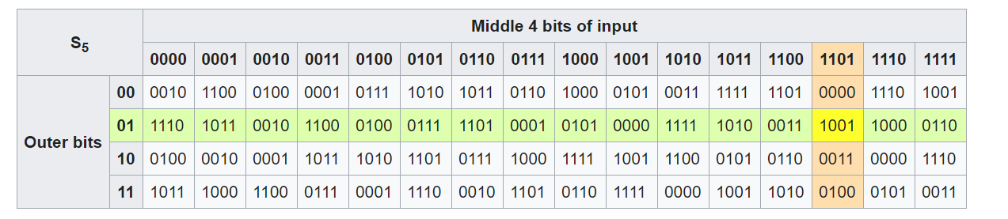

Slide 12
Birthday attacks
A birthday attack is a name used to refer to a class of brute-force attacks. It is a type of cryptographic attack that exploits the mathematics behind the birthday problem in probability theory. This attack can be used to abuse communication between two or more parties.
It gets its name from the surprising result that the probability that two or more people in a group of 23 people share the same birthday is greater than 50.7%. Such a result is called a birthday paradox.
Reference 2 : 11.2

Slide 13
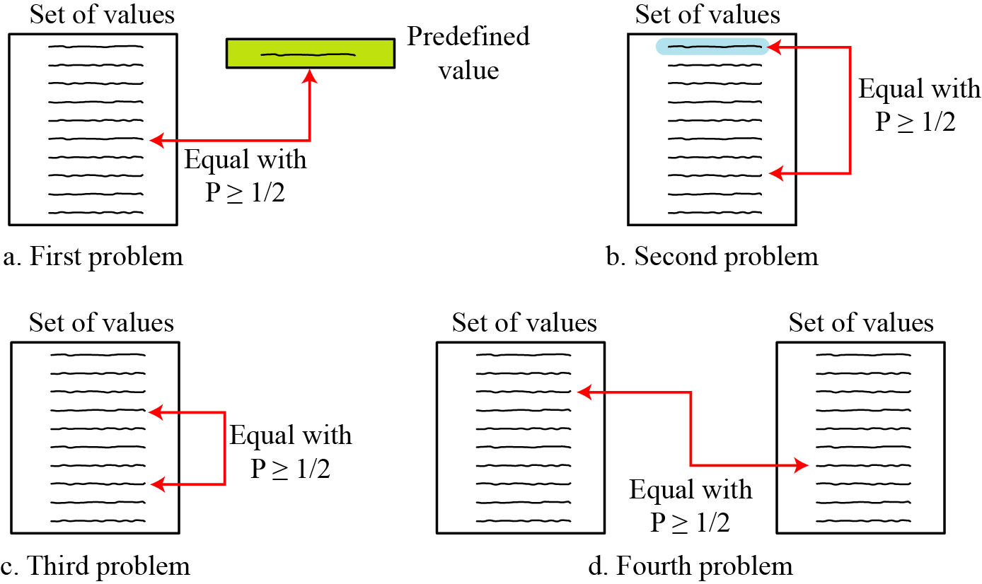
Four birthday problems

Slide 14
The following briefly states the four birthday problems:
Problem 1: What is the minimum number, k, of students in a classroom such that it is likely that at least one student has a predefined birthday?
Problem 2: What is the minimum number, k, of students in a classroom such that it is likely that at least one student has the same birthday as the student selected by the professor? This problem can be generalized as follows.
Problem 3: What is the minimum number, k, of students in a classroom such that it is likely that at least two students have the same birthday?
Problem 4: We have two classes, each with k students. What is the minimum value of k so that it is likely that at least one student from the first classroom has the same birthday as a student from the second classroom?

Slide 15
Example problems on pigeonhole principle
How many cards must be selected from a standard deck of 52 cards to guarantee that at least three cards of the same suit are chosen?
How many cards must be selected to guarantee that at least three hearts are selected ?

Slide 16
Birthday paradox
Birthday attack: This attack is based on the birthday paradox, which is a powerful tool that is often used in cryptanalysis.
How many people are needed at a party such that there is a reasonable chance that at least two people have the same birthday?

Slide 17
MD5, which was one of the standard hash functions for a long time, creates digests of 128 bits. To launch a collision attack, the adversary needs to test 2⁶⁴ (2¹²⁸/2) tests in the collision algorithm. Even if the adversary can perform 2³⁰ (more than one billion) tests in a second, it takes 2³⁴ seconds (more than 500 years) to launch an attack. This type of attack is based on the Random Oracle Model. It has been proved that MD5 can be attacked on less than 2⁶⁴ tests because of the structure of the algorithm.

Slide 18
SHA-1, a standard hash function developed by NIST, creates digests of 160 bits. The function is attacks. To launch a collision attack, the adversary needs to test 2^{160/2} = 2⁸⁰ tests in the collision algorithm. Even if the adversary can perform 2³⁰ (more than one billion) tests in a second, it takes 2⁵⁰ seconds (more than ten thousand years) to launch an attack. However, researchers have discovered some features of the function that allow it to be attacked in less time than calculated above.

Slide 19
The new hash function, that is likely to become NIST standard, is SHA-512 (see Chapter 12), which has a 512-bit digest. This function is definitely resistant to collision attacks based on the Random Oracle Model. It needs 2^{512/2} = 2²⁵⁶ tests to find a collision with the probability of 1/2.

Slide 20
A cryptographic hash function uses a digest of 64 bits. How many digests does Eve need to create to find the original message with the probability more than 0.5?
Solution
The number of digests to be created is k ≈ 0.69 × 2^{n} ≈ 0.69 × 2⁶⁴. This is a large number. Even if Eve can create 2³⁰ (almost one billion) messages per second, it takes 0.69 × 2³⁴ seconds or more than 500 years. This means that a message digest of size 64 bits is secure with respect to preimage attack, but, as we will see shortly, is not secured to collision attack.

Slide 21
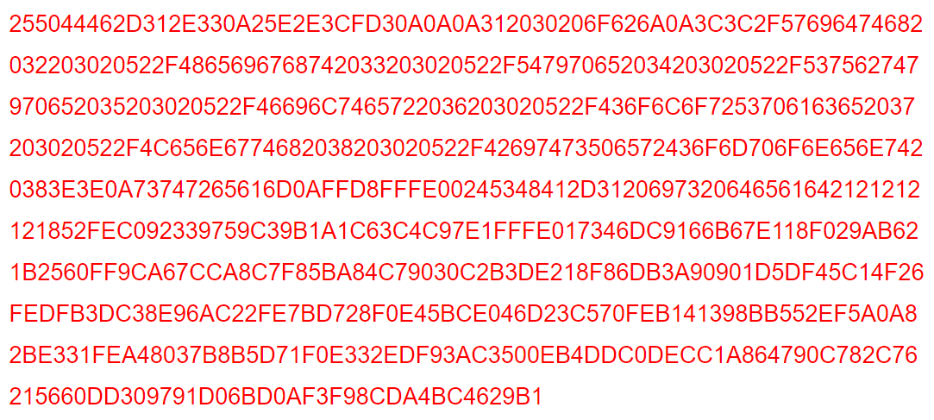
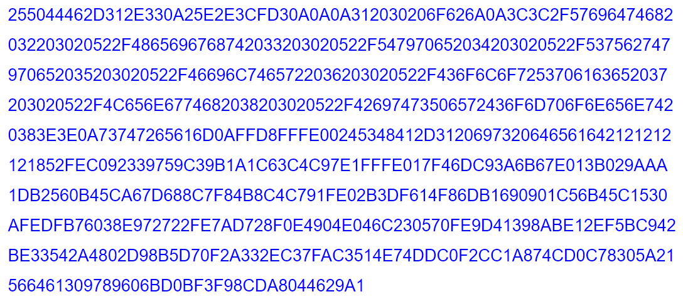
Both the below hexadecimal gives same sha 1 value
SHA1 sum

Slide 22
Thank You!
Next Class
Mandatory reading for the next class
https://sweet32.info/
https://teskalabs.com/blog/teskalabs-bulletin-160826-seacat-sweet32-issue
10 June 2020
22

Slide 23


Rajashree S
Computer Science and Engineering
PES University, Bengaluru
10 June 2020
23

